Slide 1
Data Mining
Introduction to Data Mining
Instructor :Dr. Hina Shakir
Acknowledgment : Christian Bizer
University of Mannheim – Prof. Bizer: Data Mining
Slide 1

Slide 2
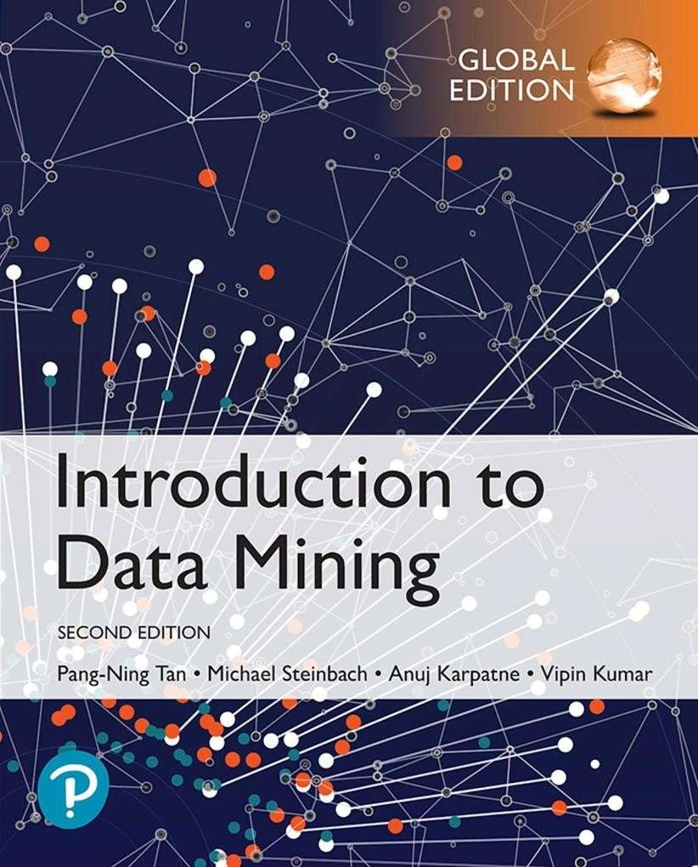
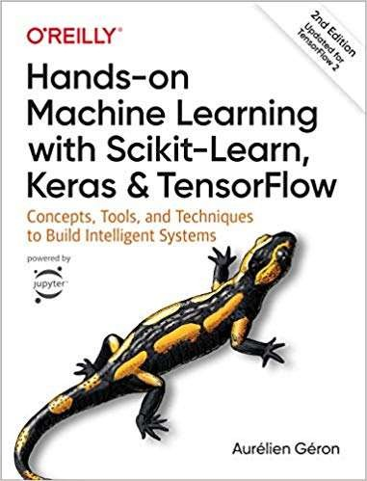
Textbooks for the Course
Pang-Ning Tan, Michael Steinbach, Vipin Kumar:
Introduction to Data Mining. 2nd Edition.
Pearson / Addison Wesley.
Aurélien Géron:
Hands-on Machine Learning with Scikit-Learn, Keras & TensorFlow.
2nd or 3rd Edition, O’Reilly, 2019 or 2022

Slide 3
Outline: Introduction to Data Mining
What is Data Mining?
Tasks and Applications
The Data Mining Process

Slide 4
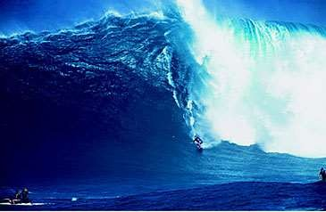
1. What is Data Mining?
Large quantities of data are collected about all aspects of our lives
This data contains interesting patterns
Data Mining helps us to
discover these patterns and
use them for decision making across all areas of society, including
Business and industry
Science and engineering
Medicine and biotech
Government
Individuals

Slide 5
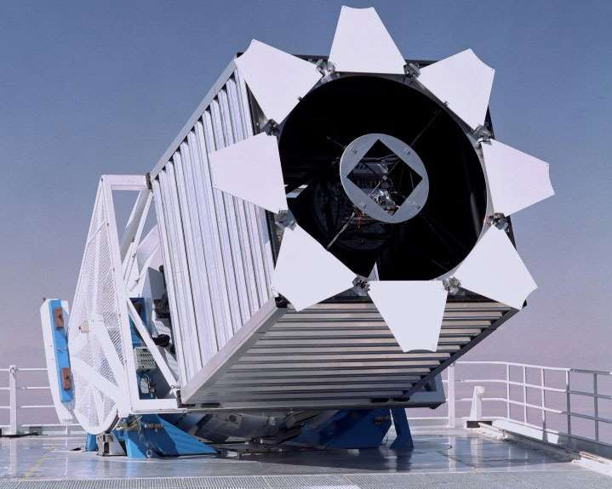
“We are Drowning in Data...”
Sloan Digital Sky Survey
≈ 200 GB/day
≈ 73 TB/year
Predict
Type of sky object: Star or galaxy?

Slide 6

“We are Drowning in Data...”
US Library of Congress
≈ 235 TB archived
≈ 40 Wikipedias
arXiv Preprint Server
> 2 million papers
Discover
Topic distributions*
Citation networks
Train
Large Language Models
* Lansdall-Welfare, et al.: Content analysis of 150 years of British periodicals. PNSA, 2017.

Slide 7


“We are Drowning in Data...”
Facebook
4 Petabyte of new data generated every day
over 300 Petabyte in Facebook‘s data warehouse
Predict
Interests and behavior of over one billion people
https://www.brandwatch.com/blog/facebook-statistics/ http://www.technologyreview.com/featuredstory/428150/what-facebook-knows/

Slide 8
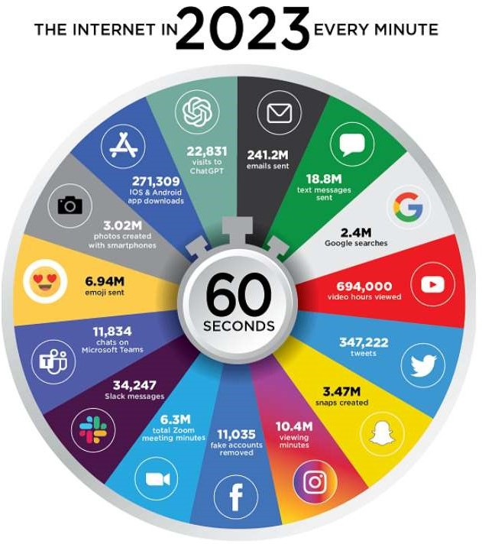
“We are Drowning in Data...”
Predict
Interests and behavior of mankind

Slide 9



“We are Drowning in Data...”
Law enforcement agencies collect unknown amounts of data from various sources
Cell phone calls
Location data
Web browsing behavior
Credit card transactions
Online profiles (Facebook)
…
Predict
Terrorist or not?
Trustworthiness

Slide 10
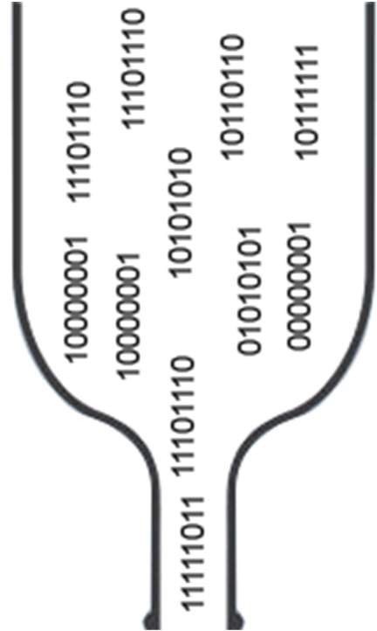
“We are Drowning in Data ... but starving for knowledge!”
← Amount of data that is collected
← Amount of data that can be looked at by humans
We are interested in the patterns, not the data itself! Data Mining methods help us to
discover interesting patterns in large quantities of data
take decisions based on the patterns

Slide 11
Definitions of Data Mining
– Definitions
Exploration & analysis,
of large quantities of data in order to discover meaningful patterns.
Non-trivial extraction of
implicit,
previously unknown, and
potentially useful information from data.
Data Mining methods
detect interesting patterns in large quantities of data
support human decision making by providing such patterns
predict the outcome of a future observation based on the patterns

Slide 12

Origins of Data Mining
Data Mining combines ideas from statistics, machine learning, artificial intelligence, and database systems
Tries to overcome short- comings of traditional
techniques concerning
Machine Learning,
AI
large amount of data
high dimensionality of data
heterogeneous and complex nature
of data
explorative analysis beyond hypothesize-and-test paradigm
Statistics
Data Mining
Database Systems

Slide 13
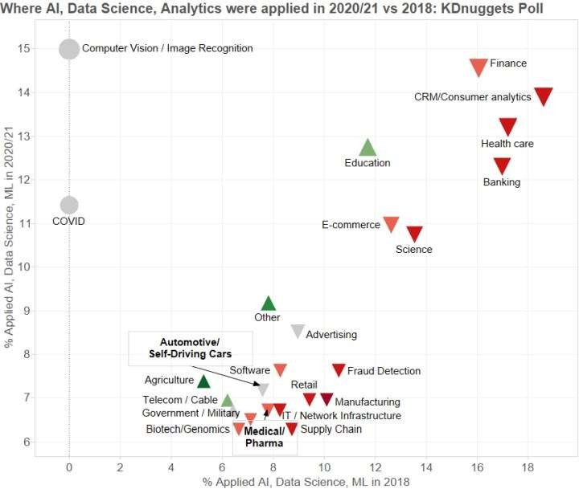


Survey on Data Mining Application Fields
Source: KDnuggets online poll, 447 (2021) and 435 (2018) participants https://www.kdnuggets.com/2021/06/poll-where-analytics-data-science-ml-applied.html

Slide 14
2. Tasks and Applications
Descriptive Tasks
Goal: Find patterns in the data.
Example: Which products are often bought together?
Predictive Tasks
Goal: Predict unknown values of a variable
given observations (e.g., from the past)
Example: Will a person click a online advertisement?
given her browsing history
Machine Learning Terminology
descriptive = unsupervised
predictive = supervised

Slide 15
Data Mining Tasks
Cluster Analysis [Descriptive]
Classification [Predictive]
Regression [Predictive]
Association Analysis [Descriptive]

Slide 16
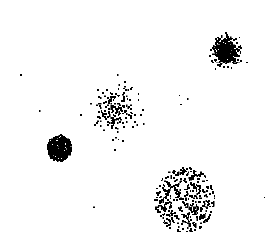
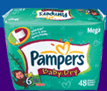
Data Mining Tasks …
Data
Clustering
Predictive Modeling
Association Rules
Anomaly Detection
Milk

Slide 17






























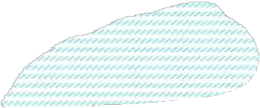

















2.1 Cluster Analysis: Definition
Given a set of data points, each having a set of attributes, and a similarity measure among them, find groups such that
data points in one group are more similar to one another
data points in separate groups are less similar to one another
Similarity Measures
Euclidean distance if attributes are continuous
other task-specific similarity measures
Goals
intra-cluster distances are minimized
inter-cluster distances are maximized
Result
A descriptive grouping of data points

Slide 18
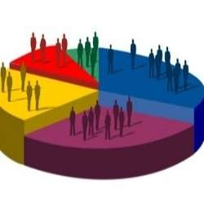
Cluster Analysis: Application 1
Application area: Market segmentation
Goal: Find groups of similar customers
where a group may be conceived as a marketing target to be reached with a distinct marketing mix
Approach:
collect information about customers
find clusters of similar customers
measure the clustering quality by observing buying patterns after targeting customers with distinct marketing mixes

Slide 19
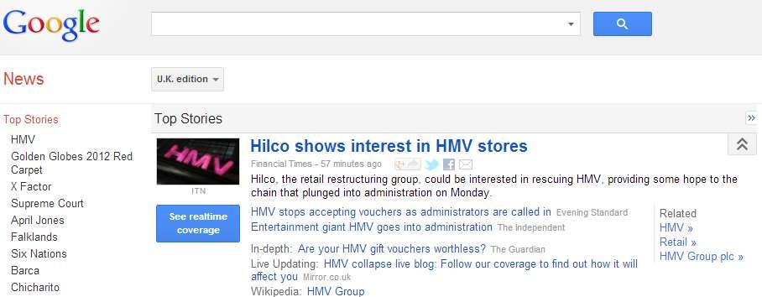
Cluster Analysis: Application 2
Application area: Document Clustering
Goal: Find groups of documents that are similar to each other based on terms appearing in them
Approach
identify frequently occurring terms in each document
form a similarity measure based on the frequencies of different terms
Application Example: Grouping of articles in Google News
University of Mannheim – Prof. Bizer: Data Mining - FSS 2024 (Version 02.02.2024) Slide 32

Slide 20
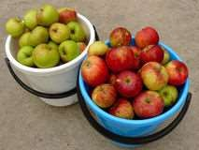
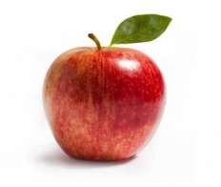
2.2 Classification: Definition
– Goal: Previously unseen records should be assigned a class from a given set of classes as accurately as possible.
?
Approach:
Given a collection of records (training set)
each record contains a set of attributes
one attribute is the class attribute (label) that should be predicted
Find a model for predicting the class attribute as a function of the values of other attributes

Slide 21
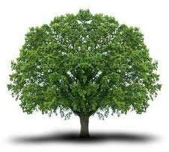
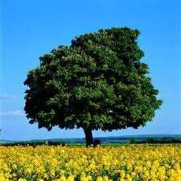
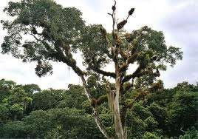
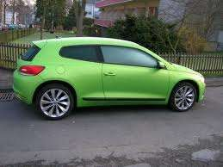

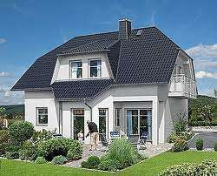
Classification: Example
– Training set:
"tree"
"tree"
"tree"
"not a tree" "not a tree" "not a tree"
– Learned model: "Trees are big, green plants without wheels."

Slide 22
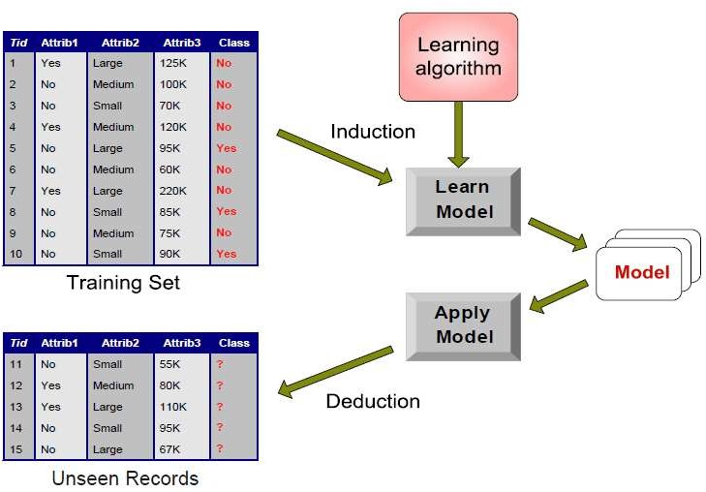
Classification: Workflow
Class/Label Attribute

Slide 23
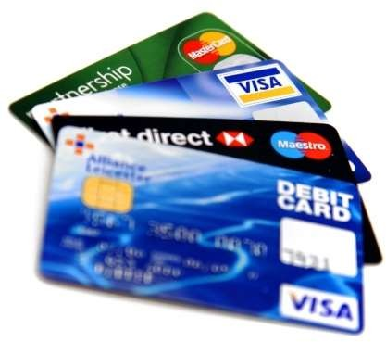
Classification: Application 1
Application area: Fraud Detection
Goal: Predict fraudulent cases in credit card transactions.
Approach:
Use credit card transactions and information about account-holders as attributes
When and where does a customer buy? What does he buy?
How often he pays on time? etc.
Label past transactions as fraud or fair transactions This forms the class attribute
Learn a model for the class attribute from the transactions
Use this model to detect fraud by observing credit card transactions on an account

Slide 24
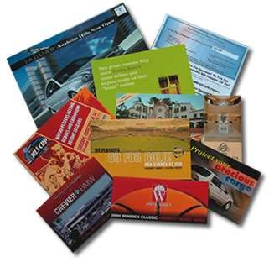
Classification: Application 2
Application area: Direct Marketing
Goal: Reduce cost of a mailing campaign by targeting only the set of consumers that likely to buy a new product
Approach:
Use data from a campaign introducing a similar product in the past
we know which customers decided to buy and which decided otherwise
this {buy, don’t buy} decision forms the class attribute
Collect various demographic, lifestyle, and company-interaction related information about the customers
age, profession, location, income, marriage status, visits, logins, etc.
Use this information to learn a classification model
Apply model to decide which consumers to target

Slide 25
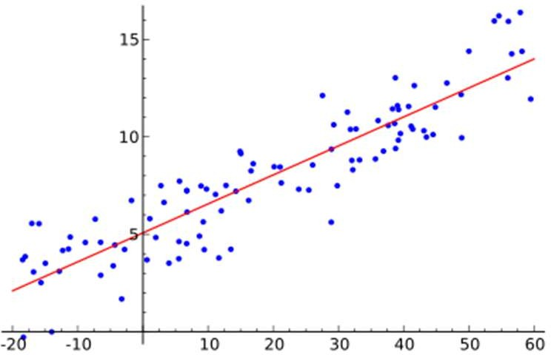
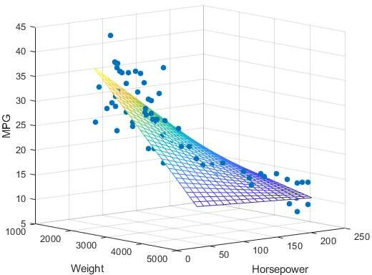
2.3 Regression
Predict a value of a continuous variable based on the values of other variables, assuming a linear or nonlinear model of dependency
Examples:
Predicting the price of a house or car
Predicting sales amounts of new product based on advertising expenditure
Predicting miles per gallon (MPG) of a car as a function of its weight and horsepower
Predicting wind velocities as a function of temperature, humidity, air pressure, etc.
– Difference to classification: The predicted attribute is continuous, while classification is used to predict nominal attributes (e.g. yes/no)

Slide 26
2.4 Association Analysis: Definition
Given a set of records each of which contain some number of items from a given collection
discover frequent itemsets and produce association rules which will predict occurrence of an item based on occurrences of other items
TID | Items
1 | Bread, Coke, Milk
2 | Beer, Bread
3 | Beer, Coke, Diaper, Milk
4 | Beer, Bread, Diaper, Milk
5 | Coke, Diaper, Milk
Frequent Itemsets
{Diaper, Milk, Beer}
{Milk, Coke}
Frequent Itemsets
{Diaper, Milk, Beer}
{Milk, Coke}
Association Rules
{Diaper, Milk} --> {Beer}
{Milk} --> {Coke}
Association Rules
{Diaper, Milk} --> {Beer}
{Milk} --> {Coke}

Slide 27
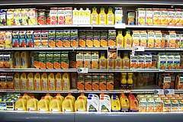
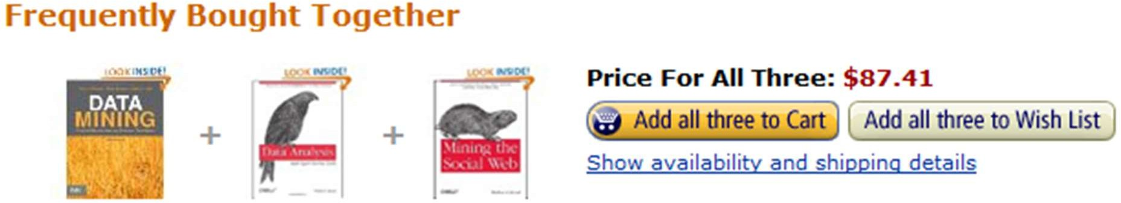

Association Rule Discovery: Applications 1
Application area: Supermarket shelf management.
Goal: To identify items that are bought together by sufficiently many customers
Approach: Process the point-of-sale data collected
with barcode scanners to find dependencies among items
A classic rule and its implications:
if a customer buys diapers and milk, then he is likely to buy beer as well
so, don’t be surprised if you find six-packs stacked next to diapers!
promote diapers to boost beer sales
if selling diapers is discontinued, this will affect beer sales as well
Application area: Sales Promotion

Slide 28
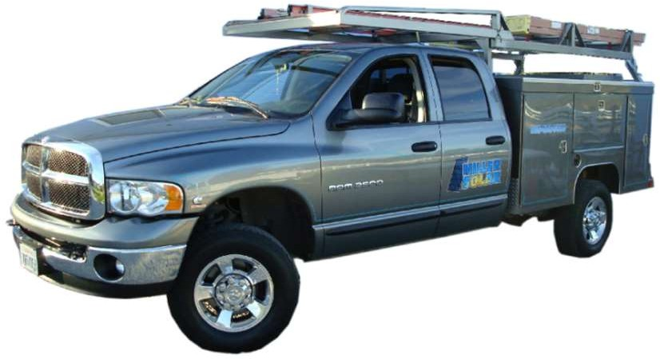
Association Rule Discovery: Application 2
Application area:
Inventory Management
Goal: A consumer appliance repair company wants to anticipate the nature of repairs on its consumer products and keep the service vehicles equipped with right parts to reduce on number of visits to consumer households
Approach: Process the data on tools and parts required in previous repairs at different consumer locations and discover the co-occurrence patterns

Slide 29
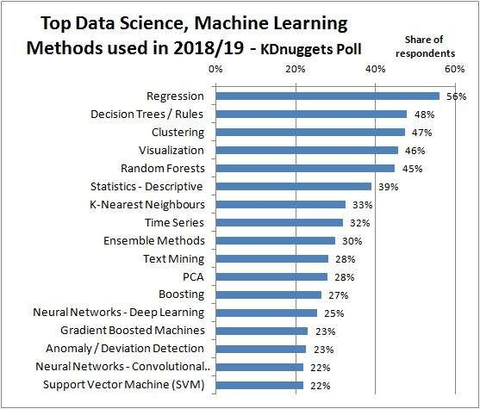
Which Methods are Used in Practice?
Source: KDnuggets online poll, 833 votes, question: methods used last year for real-world app? https://www.kdnuggets.com/2019/04/top-data-science-machine-learning-methods-2018-2019.html

Slide 30
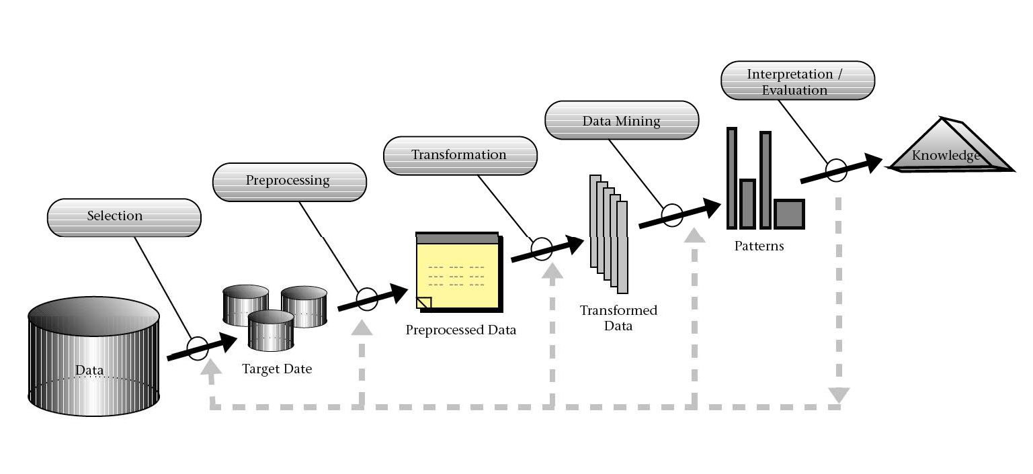
3. The Data Mining Process
a
Source: Fayyad et al. (1996)

Slide 31
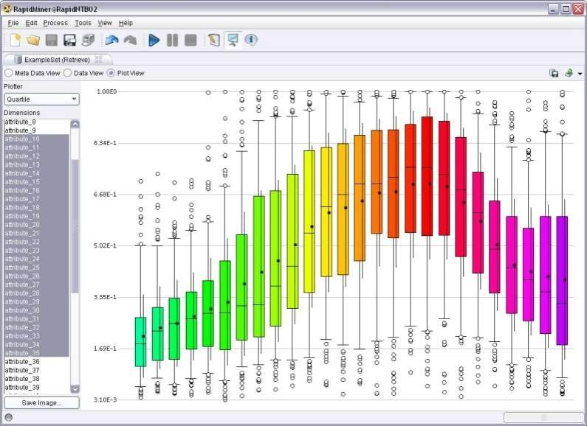
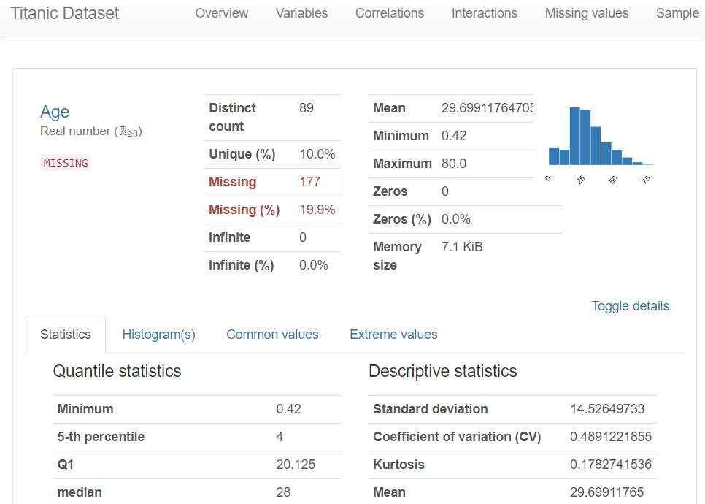
3.1 Selection and Exploration
Selection
What data is potentially useful for the task at hand?
What data is available?
What do I know about the quality of the data?
Exploration / Profiling
Get an initial understanding of the data
Calculate basic summarization statistics
Visualize the data
Identify data problems such as outliers, missing values, duplicate records

Slide 32
3.2 Preprocessing and Transformation
Transform data into a representation that is suitable for the chosen data mining methods
scales of attributes (nominal, ordinal, numeric)
number of dimensions (represent relevant information using less attributes)
amount of data (determines hardware requirements)
Methods
discretization and binarization
feature subset selection / dimensionality reduction
attribute transformation / text to term vector / embeddings
aggregation, sampling
integrate data from multiple sources
Good data preparation is key to producing valid and reliable models
Data integration and preparation is estimated to take 70-80% of the time and effort of a data mining project

Slide 33
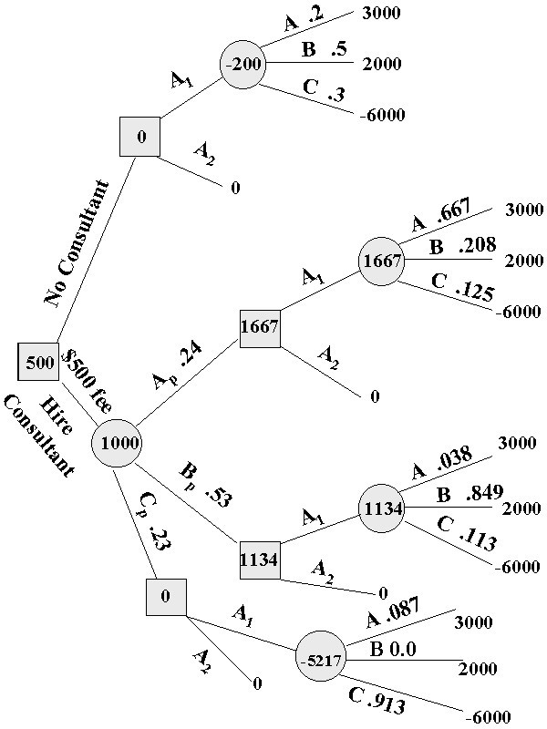
3.3 Data Mining
Input: Preprocessed Data
Output: Model / Patterns
Apply data mining method
Evaluate resulting model / patterns
Iterate
experiment with different hyperparameter settings
experiment with multiple alternative methods
improve preprocessing and feature generation
increase amount or quality of training data

Slide 34
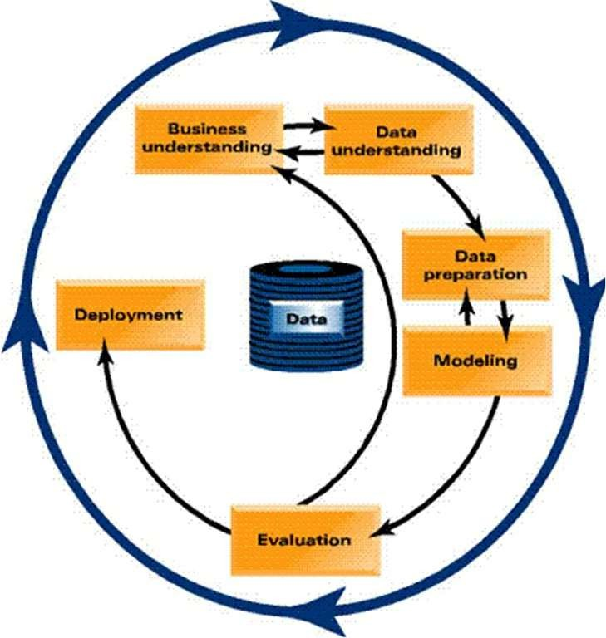
3.4 Deployment
Use model in the business context
Keep iterating in order to maintain and improve model
CRISP-DM Process Model

Slide 35
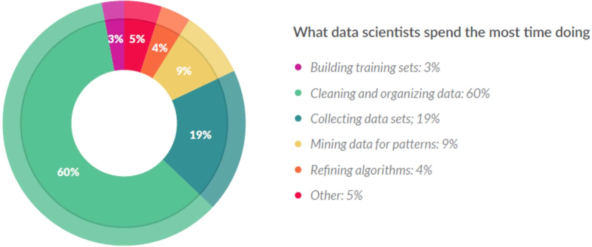
How Do Data Scientists Spend Their Days?
Source: CrowdFlower Data Science Report 2016: http://visit.crowdflower.com/data-science-report.html

Slide 36
Literature for this Chapter
Pang-Ning Tan, Michael Steinbach, Vipin Kumar:
Introduction to Data Mining. 2nd Edition.
Pearson / Addison Wesley.
Chapter 1: Introduction
Chapter 2: Data

Slide 37
Literature – Python
Scikit-learn Documentation: https://scikit-learn.org/stable/ user_guide.html
Aurélien Géron: Hands-on Machine Learning with Scikit-Learn, Keras & TensorFlow.
2nd Edition, O’Reilly, 2019

